Slide 1







GenGraph: A Hardware Acceleration Framework for Sequence-to-Graph Mapping
Damla Senol Cali et al.
https://damlasenolcali.github.io
TECHCON’21 ⎼ September 14, 2021
Notes:
Hello, I am Damla Senol Cali. Thank you so much for joining to my talk!
Today, I’ll be talking about our work GenGraph: A Hardware Acceleration Framework for Sequence-to-Graph Mapping

Slide 2
Genome Sequencing
Genome sequencing: Enables us to determine the order of the DNA sequence in an organism’s genome
Plays a pivotal role in:
Personalized medicine
Outbreak tracing
Understanding of evolution
Challenges:
There is no sequencing machine that takes long DNA as an input, and gives the complete sequence as output
Sequencing machines extract small randomized fragments of the original DNA sequence
Notes:
[CLICK] Genome sequencing, which enables us to determine the DNA sequence of an organism, [CLICK] plays a pivotal role in areas such as personalized medicine, outbreak tracing (like COVID-19), and the understanding of evolution.
However, there is no …

Slide 3
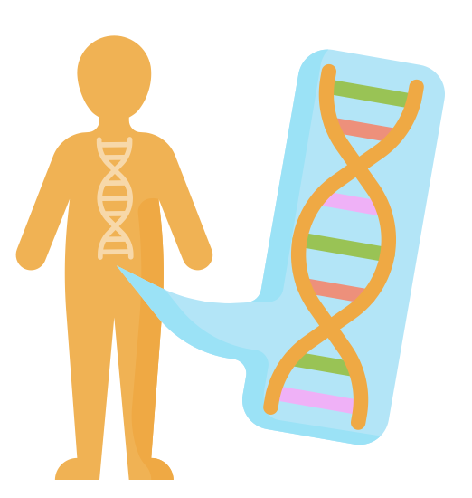




Genome Sequencing (cont’d.)
Chopped DNA
fragments
Sequenced reads
Sample Collection
Sequencing
Large DNA
molecule
Preparation
Genome Sequence Analysis
Notes:
So the process starts with …

Slide 4
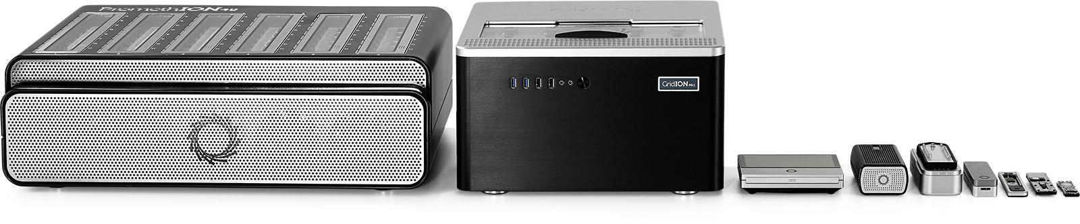
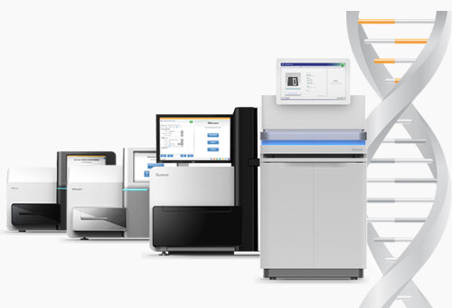
Sequencing Technologies
Oxford Nanopore (ONT)
PacBio
Illumina
Short reads: a few hundred base pairs and error rate of ∼0.1%
Long reads: thousands to millions of base pairs and error rate of 5–10%
Notes:
ONT, PacBio, Illumina
[CLICK] Based on the sequencing device, we obtain either short reads or long reads.

Slide 5
Genome Sequence Analysis
ACGTACCCCGT
TTTTTTTAATT
ACGAGCGGGT
GATACACTGTG
AAAAAAAAAA
Reads
CTAGGGACCTT
ACGACGTAGCT
Read Mapping, method of aligning the reads against the reference genome in order to detect matches and variations.
De novo Assembly, method of merging the reads in order to construct the original sequence.
Reference
Genome
Original
Sequence
Reads
Mapped Reads
Reads
Assembled Reads
Notes:
When I say analysis, what do I mean. What I mean is how we will analyze these reads.
They can then be analyzed following two different approaches:
First one is Read mapping and it is the process of aligning the reads against the reference genome to detect sequencing errors and variations in the sequenced genome.
And the second approach is de novo assembly, which is the method of combining the reads to construct the original sequence when a reference genome does not exist.

Slide 6
GSA with Read Mapping
Read mapping: First key step in genome sequence analysis (GSA)
Aligns reads to one or more possible locations within the reference genome, and
Finds the matches and differences between the read and the reference genome segment at that location
Multiple steps of read mapping require approximate string matching
Approximate string matching (ASM) enables read mapping to account for sequencing errors and genetic variations in the reads
Bottlenecked by the computational power and memory bandwidth limitations of existing systems
Notes:
[CLICK] In read mapping, we take each read, align it to one or more possible locations within the reference genome, and find the matches and differences between the read and the reference genome segment at that location.
[CLICK] Multiple steps of read mapping must account for the sequencing errors, and for the differences caused by genetic variations. As a result, read mapping must perform approximate string matching (ASM).
[CLICK] However, as shown in many prior work, read mapping is bottlenecked by the computational power and memory bandwidth limitations of existing systems.

Slide 7
Read Mapping Pipeline
Reference genome
Indexing
(Pre-processing step to generate index of reference)
reference bias
Hash-table based index
Reads
Seeding
(Query the index)
Potential mapping
locations
Pre-Alignment Filtering
(Filter out dissimilar sequences)
Remaining potential mapping locations
Reference
segment
Read Alignment
(Perform distance/score calculation & traceback)
Optimal alignment
Query read
Notes:
Read mapping can be seen as a four-step process (i.e., seed-and-extend). I won’t be able to go into the details but in indexing, we generate a hash-table based index. In seeding, we query this index to find the candidate mapping locations. Then in the optional pre-alignment filtering step we filter out the dissimilar sequences. And finally, in alignment step, we determine the best location of the query read and perform traceback to find the optimal alignment.
In read mapping, we start with a linear sequence of a single reference genome. However, this linear representation of the reference genome results with ignoring the variations that exist in a population (i.e., genetic diversity) and introducing biases for the downstream analysis. To address these limitations, recently, graph-based representations of the genomes (i.e., genome graphs) have gained attention.

Slide 8
Genome Graphs
Genome graphs:
Include the reference genome together with genetic variations
Provide a compact representation
Enable us to move away from aligning with single reference genome (reference bias) and toward using the sequence diversity
Reference #1: ACGTACGT
ACGTACGT
Notes:
Genome graphs include …

Slide 9
Genome Graphs
Genome graphs:
Include the reference genome together with genetic variations
Provide a compact representation
Enable us to move away from aligning with single reference genome (reference bias) and toward using the sequence diversity
Reference #1: ACGTACGT
Reference #2: ACGGACGT
ACGTACGT

Slide 10
Genome Graphs
Genome graphs:
Include the reference genome together with genetic variations
Provide a compact representation
Enable us to move away from aligning with single reference genome (reference bias) and toward using the sequence diversity
T
Reference #1: ACGTACGT
Reference #2: ACGGACGT
ACG
ACGT
G

Slide 11
Genome Graphs
Genome graphs:
Include the reference genome together with genetic variations
Provide a compact representation
Enable us to move away from aligning with single reference genome (reference bias) and toward using the sequence diversity
T
Reference #1: ACGTACGT
Reference #2: ACGGACGT
Reference #3: ACGTTACGT
ACG
ACGT
G

Slide 12
Genome Graphs
Genome graphs:
Include the reference genome together with genetic variations
Provide a compact representation
Enable us to move away from aligning with single reference genome (reference bias) and toward using the sequence diversity
T
Reference #1: ACGTACGT
Reference #2: ACGGACGT
Reference #3: ACGTTACGT
ACG
ACGT
T
G

Slide 13
Genome Graphs
Genome graphs:
Include the reference genome together with genetic variations
Provide a compact representation
Enable us to move away from aligning with single reference genome (reference bias) and toward using the sequence diversity
T
Reference #1: ACGTACGT
Reference #2: ACGGACGT
Reference #3: ACGTTACGT
Reference #4: ACGACGT
ACG
ACGT
T
G

Slide 14
Genome Graphs
Genome graphs:
Include the reference genome together with genetic variations
Provide a compact representation
Enable us to move away from aligning with single reference genome (reference bias) and toward using the sequence diversity
T
Reference #1: ACGTACGT
Reference #2: ACGGACGT
Reference #3: ACGTTACGT
Reference #4: ACGACGT
ACG
ACGT
T
G

Slide 15
Problem & Motivation
Traditional read mapping causes reference bias
Aligning sequences to graphs is a newer field and only a few software tools exist for graph-based GSA
Graph-based analysis exacerbates mapping’s bottlenecks
Hardware acceleration of sequence-to-graph mapping: important but unexplored research problem
Notes:
So, [CLICK] since traditional read mapping causes reference bias,
[CLICK] aligning sequences to graphs emerges a newer field and practical tools only start to emerge, where most of the existing tools are specialized for one purpose.
[CLICK] Given the additional complexities and overheads of processing a genome graph instead of a linear reference genome, graph-based analysis exacerbates analysis bottlenecks such as read-to-reference mapping.
[CLICK} Thus, HW acceleration of sequence-to-graph mapping is an important but unexplored research problem.

Slide 16
GenGraph: First Graph Mapping Accelerator
Our Goal:
Design high-performance, scalable, power- and area-efficient hardware accelerators that alleviate bottlenecks in both
the seeding and alignment steps of sequence-to-graph mapping with support for both short and long reads
GenGraph:
MinSeed: The first minimizer-based seeding hardware
BitAlign: The first sequence-to-graph alignment hardware based on modified GenASM algorithms and accelerators
Notes:
[CLICK] Thus, in GenGraph, our goal is to design …
[CLICK] To this end, [CLICK] we propose GenGraph, the first hardware acceleration framework for sequence-to-graph mapping and alignment.
GenGraph consists of two main components:
[CLICK] MinSeed, …
[CLICK] BitAlign, …

Slide 17
Overview of GenGraph
Main Memory (graph-based reference & index)
frequencies
seed locations
graph nodes
3
5
7
GenGraph
MinSeed (MS)
BitAlign (BA)
Minimizer Scratchpad
Seed Scratchpad
DC-SRAM
(Input Scratchpad)
8
Generate Bitvectors
Hop Queues
9
minimizers
2
4
6
10
Find Minimizers
Filter
Frequencies
Calculate
Seed Regions
TB-SRAMs
(Bitvector Scratchpad)
query k-mers
Host CPU
11
1
Read
Scratchpad
Perform
Traceback
query
read
Notes:
Before GenGraph execution starts, as the pre-processing steps, each chromosome’s graph structure is generated, then each graph’s nodes are indexed, and both the resulting graph and hash-table index are pre-loaded to the main memory.
[CLICK] GenGraph execution starts when the query read is streamed from the host CPU and MinSeed writes it to the read scratchpad ( 1 ).
[CLICK] Using all of the k-mers of the query read, MinSeed finds the minimizers and writes them to the minimizer scratchpad ( 2 ).
[CLICK] For each minimizer, MinSeed fetches its frequency from the hash table at the main memory ( 3 ) and [CLICK] filters out the minimizers whose frequency is above an user-defined threshold ( 4 ). [CLICK] Next, MinSeed fetches the seed locations of the remaining minimizers from the main memory, and writes them to the seed scratchpad ( 5 ).
[CLICK] Finally, MinSeed calculates the candidate reference region for each seed ( 6 ),
[CLICK] fetches the graph nodes from the memory for each candidate region and writes them to the input scratchpad ( 7 ).
Once MinSeed sends the subgraph corresponding to the candidate reference region along with the query read, [CLICK] BitAlign execution starts with generating the bitvectors ( 8 ) required for the distance calculation step of the alignment (i.e., seed-extension).
[CLICK] While generating these bitvectors, BitAlign writes them to the hop queues in order to handle the hops required for the graph alignment ( 9 ),
[CLICK] and also, to the bitvector scratchpad ( 10 ).
Once BitAlign finishes generating and writing all the bitvectors, [CLICK] it starts reading them back from the bitvector scratchpad, performs the traceback operation, and finds the optimal alignment between the subgraph and the query read
(11).

Slide 18
MinSeed HW
Three computation modules responsible for finding the minimizers, filtering the frequencies of minimizers, and finding the associated regions of every seed location
Three scratchpads for storing the query read, its minimizers, and seed locations
The memory interface, which handles the frequency, seed location, and subgraph accesses
Notes:
Let’s look at the HW design of MinSeed.

Slide 19
BitAlign HW
Linear cyclic systolic array-based accelerator
Hop queue registers to incorporate the hops by feeding the bitvectors of non-neighbor characters/nodes
Notes:
Let’s look at the HW design of BitAlign.

Slide 20
Overall System of GenGraph
A single GenGraph consists of 8 MinSeed modules that exploit data-level parallelism when performing seeding
Each MinSeed module has exclusive access to one HBM2E channel
Each MinSeed module is connected to a single BitAlign module
We hide the latency of MinSeed when performing seeding while running sequence-to-graph alignment with BitAlign
Notes:
We replicate the content of each HBM2E stack (i.e., graph-based reference and hash table based index) among the 4 independent stacks.
Within each stack, we distribute the graph and index structures of the 24 chromosomes based on their sizes among the 8 independent channels.

Slide 21
Use Cases of GenGraph
End-to-End Sequence-to-Graph Mapping
The whole GenGraph design (MinSeed + BitAlign) should be executed
We support both short and long reads
Sequence-to-Graph Alignment
BitAlign can be executed by itself without the need of an initial seeding tool/accelerator
BitAlign can also be used for sequence-to-sequence alignment since it is a special and simpler variant of sequence-to-graph alignment
Seeding
MinSeed only can be used as the seeding module for both graph-based mapping and linear traditional mapping
MinSeed is orthogonal to be coupled with any alignment tool or accelerator
Notes:
BitAlign can be executed by itself without the need of an initial seeding tool/accelerator
BitAlign can also be used for sequence-to-sequence alignment since it is a special and simpler variant of sequence-to-graph alignment

Slide 22
Evaluation Methodology
We evaluate GenGraph using:
Synthesized SystemVerilog models of the MinSeed and BitAlign accelerator datapaths
Simulation- and spreadsheet-based performance modeling
4 x 24GB HBM2E stacks, each with 8 independent channels
1 MinSeed and 1 BitAlign HW per each channel (32 in total)
Baseline tools:
GraphAligner and vg for sequence-to-graph mapping
PaSGAL for sequence-to-graph alignment
Darwin, GenAx, and GenASM for sequence-to-sequence alignment
Simulated datasets for both short and long reads
Notes:
We evaluate ...
We model the memory component as a 4 stacks of HBM2, each with ...
For each channel, we have ...
We compare GenGraph with [CLICK] ... and using [CLICK] simulated reads ...
We evaluate GenGraph using the latest major release of the human genome assembly, GRCh38 [2], as the starting reference genome. For the variations, we use 7 VCF files for HG001-007 from the GIAB project (v3.3.2) [105].

Slide 23
Key Results – Area & Power
Based on our synthesis of MinSeed and BitAlign accelerator datapaths using the Synopsys Design Compiler with a 28nm process (@ 1GHz):
Notes:
Based on …
We find that the total area overhead of GenGraph attached to all 32 channels is around 25mm2 and the total power consumption is around 17 W.
We find that the main contributors for the area overhead and power consumption are (1) hopQueueRegisters since they constitute more than 60% of the area and power of BitAlign-DC logic, and (2) the bitvector scratchpads (TB- SRAMs).
Here we show the area and power breakdown of the compute (i.e., logic) units and the memory components (i.e., scratchpads) in GenGraph, and the total area overhead and power consumption of (1) a single GenGraph accelerator (attached to a single channel), (2) 8 GenGraph accelerators (in a single stack with 8 channels), and (3) 32 GenGraph accelerators (in 4 stacks).

Slide 24
Key Results – GenGraph with Long Reads (I)
GenGraph provides 8.8× throughput improvement over GraphAligner’s 12-thread execution,
while reducing the power consumption by 4.9×
Notes:
When we look at our long read analysis, we find that [CLICK][CLICK]

Slide 25
Key Results – GenGraph with Long Reads (II)
GenGraph provides 7.3× throughput improvement over vg’s 12-thread execution,
while reducing the power consumption by 6.5×

Slide 26
Key Results – GenGraph with Short Reads (I)
GenGraph provides 168× throughput improvement over GraphAligner’s 12-thread execution,
while reducing the power consumption by 4.7×
Notes:
and when we look at our short read analysis, we find that [CLICK][CLICK]

Slide 27
Key Results – GenGraph with Short Reads (II)
GenGraph provides 726× throughput improvement over vg’s 12-thread execution,
while reducing the power consumption by 4.9×

Slide 28
Key Results – BitAlign (Graph Alignment)
BitAlign provides 41×-539× speedup over
the 48-thread AVX512-supported
execution of PaSGAL
Notes:
Let’s look at the key results for the sequence-to-graph alignment module of GenGraph, which is BitAlign.

Slide 29
Key Results – BitAlign (Linear Alignment)
BitAlign can be used for both sequence-to-sequence alignment and sequence-to-graph alignment
The cost of more functionality: Extra hop queue registers in BitAlign
However, we do not sacrifice any performance
For long reads (over GACT of Darwin and GenASM):
4.8× and 1.2× throughput improvement,
1.9× and 5.2× higher power consumption, and
1.4× and 2.3× higher area overhead
For short reads (over SillaX of GenAx and GenASM):
2.4× and 1.3× throughput improvement
Notes:
GACT of Darwin is optimized for long reads, SillaX of GenAx is optimized for short reads, and GenASM is optimized for both short and long reads.
We use the optimum configuration of each accelerator reported in their corresponding papers.

Slide 30
Conclusion
Problem:
Traditional read mapping causes reference bias
Aligning sequences to graphs is a newer field and only a few software tools exist for graph-based GSA
Graph-based analysis exacerbates mapping’s bottlenecks
Hardware acceleration of sequence-to-graph mapping: important but unexplored research problem
Key Contributions:
GenGraph: First acceleration framework for sequence-to-graph mapping
MinSeed: First minimizer-based seeding accelerator
BitAlign: First sequence-to-graph alignment accelerator based upon our new bitvector-based, highly-parallel algorithm
Key Results: GenGraph and BitAlign provide significant speedups compared to the software baselines, while reducing the power consumption
Notes:
To summarize,
So, since traditional read mapping causes reference bias, aligning sequences to graphs emerges a newer field and practical tools only start to emerge, where most of the existing tools are specialized for one purpose. Given the additional complexities and overheads of processing a genome graph instead of a linear reference genome, graph-based analysis exacerbates analysis bottlenecks of read mapping. Thus, HW acceleration of sequence-to-graph mapping is an important but unexplored research problem.
Thus, in this work, we propose GenGraph, the first hardware acceleration framework for sequence-to-graph mapping. We base GenGraph on a memory-efficient minimizer-based seeding algorithm and a novel bitvector-based, highly- parallel sequence-to-graph alignment algorithm. We co-design both of our algorithms with high-performance, area- and power-efficient hardware accelerators, and propose the first HW accelerators for both.
We compare GenGraph and BitAlign with state-of-the-art sequence-to-graph mappers and aligners, and we find that both provides significant speedup compared to the the baselines, while reducing the power consumption.

Slide 31
GenGraph: A Hardware Acceleration Framework for Sequence-to-Graph Mapping
Damla Senol Cali et al.
https://damlasenolcali.github.io
TECHCON’21 ⎼ September 14, 2021
This work was supported in part by Semiconductor Research Corporation (SRC).
Notes:
Thank you!

Slide 32
Backup Slides (Sequencing)

Slide 33
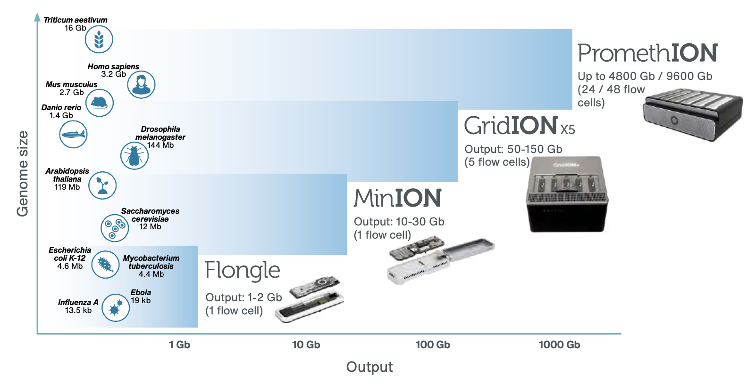
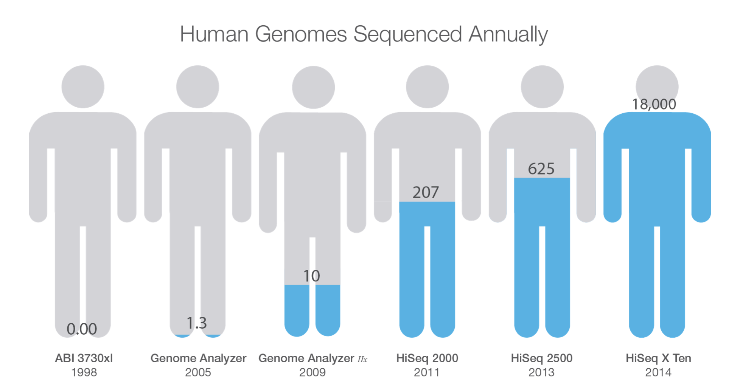
Current State of Sequencing
Notes:
As the sequencing devices become cheaper and more accessible, the amount of genomics data that is generated gets much higher.

Slide 34
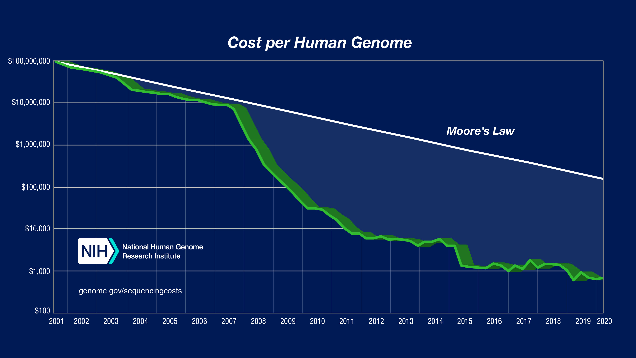
Current State of Sequencing (cont’d.)
*From NIH (https://www.genome.gov/about-genomics/fact-sheets/DNA-Sequencing-Costs-Data)
Notes:
However, the compute power doesn’t match up with this trend.
Modern sequencing machines generate read fragments at an exponentially higher rate than prior sequencing technologies, with their growth far outpacing the growth in computational power in recent years
For example, the Illumina NovaSeq 6000 system can sequence about 48 human whole genomes at 30× genome coverage (the av- erage number of times a genomic base is sequenced) in about two days. However, analyzing (performing mapping and variant calling) the sequencing data of a single human genome requires over 32 CPU hours on a 48-core Intel Xeon processor, 23 of which are spent on read mapping

Slide 35
Current State of Sequencing (cont’d.)
Computation is a bottleneck!
*From NIH (https://www.genome.gov/about-genomics/fact-sheets/DNA-Sequencing-Costs-Data)
Notes:
However, the compute power doesn’t match up with this trend.
Modern sequencing machines generate read fragments at an exponentially higher rate than prior sequencing technologies, with their growth far outpacing the growth in computational power in recent years
For example, the Illumina NovaSeq 6000 system can sequence about 48 human whole genomes at 30× genome coverage (the av- erage number of times a genomic base is sequenced) in about two days. However, analyzing (performing mapping and variant calling) the sequencing data of a single human genome requires over 32 CPU hours on a 48-core Intel Xeon processor, 23 of which are spent on read mapping

Slide 36
Backup Slides (GenGraph)

Slide 37
GenGraph – Graph Structure
Notes:
1.4 GB in total
620 MB nodes
740 MB chars
106 MB edges
We use the stats (i.e., number of nodes, number of edges and total sequence length) for each chromosome’s associated graph to determine the data sizes of our graph structure. Based on our analysis, we find that each node in the nodes table requires 32B per entry and the total size of the nodes table is #nodes * 32B. Since we can store characters in the sequences table using a 2-bit representation (since we only have 4 possible characters), the total size is total sequence length * 2bit. We also find that each entry in the edges table requires 4B, thus the total size of the edges table is #edges * 4B.
we use three separate table structures: (1) the nodes table, which stores the nodes of the graphs as the <node id> as the key and the <node’s sequence’s length, starting address at the sequences table, node’s number of outgoing edges, starting address at the edges table> as the value; (2) the sequences table, which stores the associated sequences of each node; and (3) the edges table, which stores the associated outgoing nodes (by node ID) of each node.

Slide 38
GenGraph – Index Structure
Notes:
9.8GB in total
In the first-level of the hash table, similar to Minimap2 [136], we have buckets to decrease the memory footprint of the index. Each entry in this first-level of the index stores <starting address of the minimizers in the corresponding bucket in the second-level, number of minimizers in the corresponding bucket>. In the second-level of the hash table, we have the minimizers. Each entry in this second-level of the index stores <hash value of the corresponding minimizer, starting address of the seed locations of the corresponding minimizer in the second-level, number of locations of the corresponding minimizer>. Minimizers are sorted based on their hash values in the second-level of the index. Finally, in the third-level of the hash table, we have the seed locations. Each entry in this third-level of the index stores <node ID of the corresponding seed location, relative offset of the corresponding seed location within the node>. Locations are grouped based on their corresponding minimizers and sorted within each group based on their values.
We use the stats (i.e., number of distinct minimizers, total number of locations, maximum number of minimizers per bucket, and maximum number of locations per minimizer) for each graph to determine the data sizes of our index structure. Based on our empirical analysis, we find that 224 is the optimum number of buckets in terms of memory footprint and the number of keys per each bucket. We also find that each bucket entry requires 4B of data, thus the total size of the first-level of the index is 224 * 4B. Each minimizer in the second-level of the index requires 12B of data, thus the total size of the second-level of the index is #distinct minimizers * 12B. Each location in the third-level of the index requires 8B of data, thus the total size of the third-level of the index is #total number of locations * 8B.

Slide 39
Minimizers
Notes:
***

Slide 40
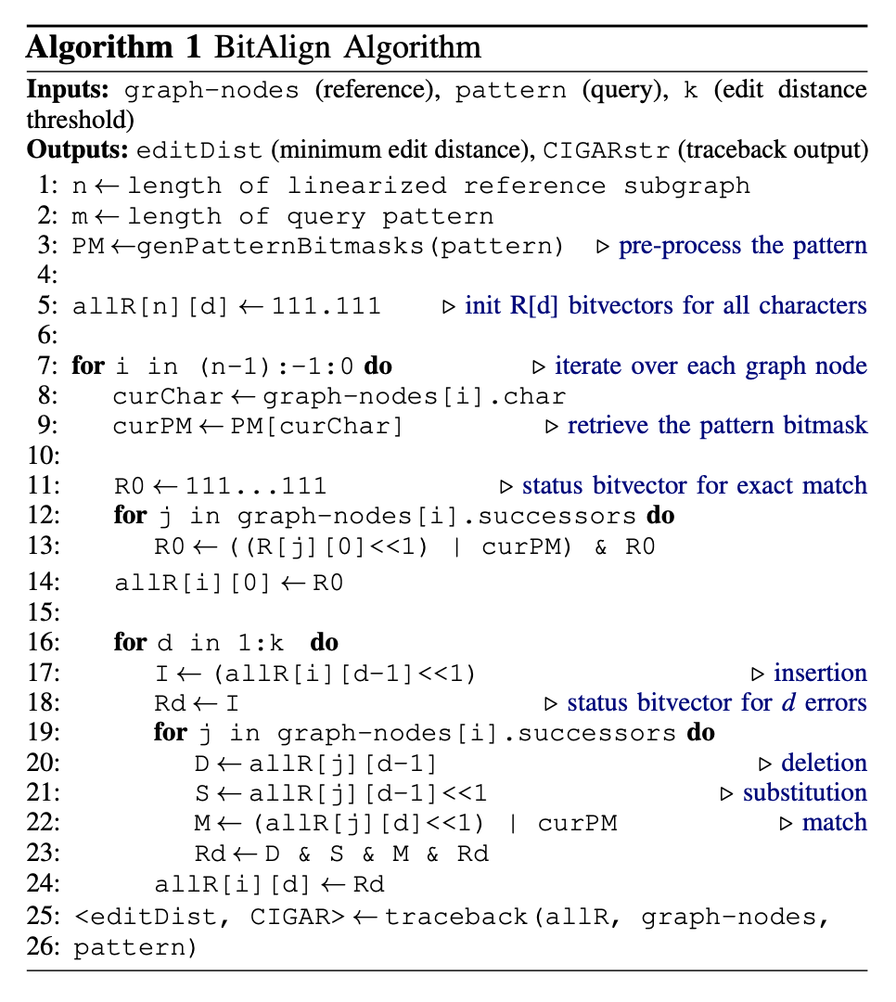
BitAlign Algorithm

Slide 41
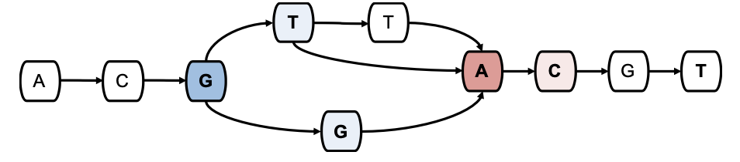
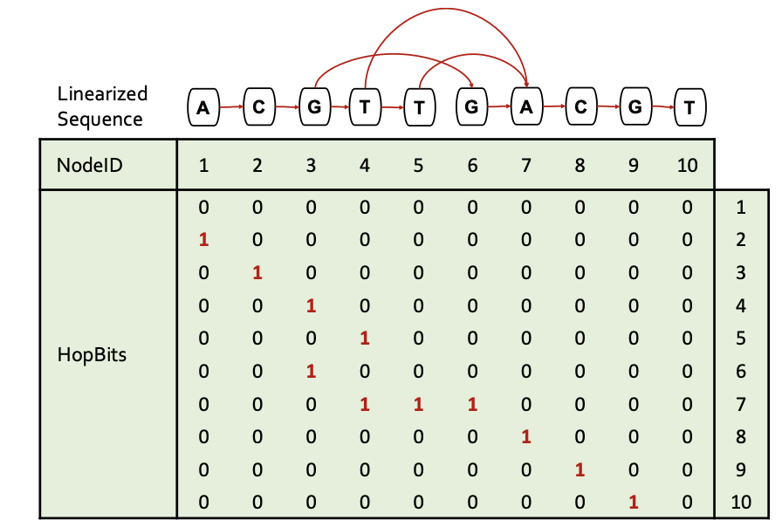
GenGraph – Hops
Notes:
***

Slide 42
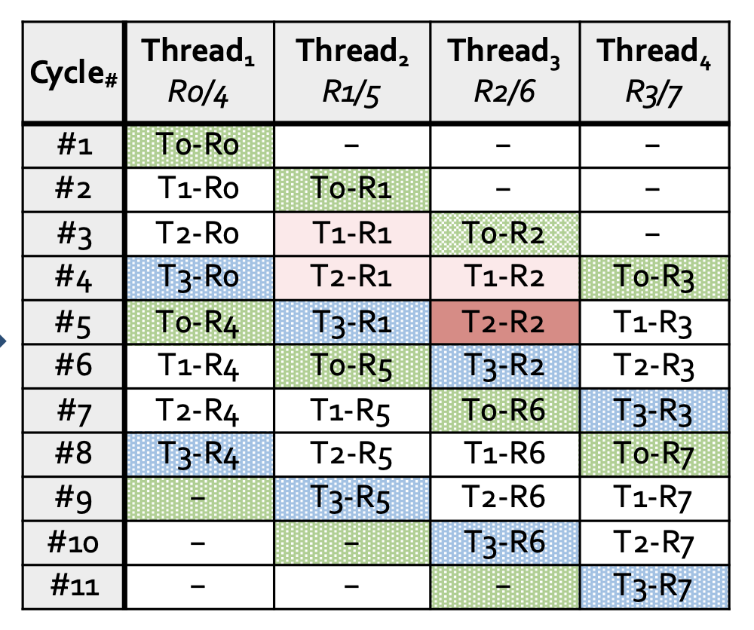
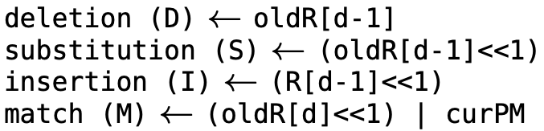
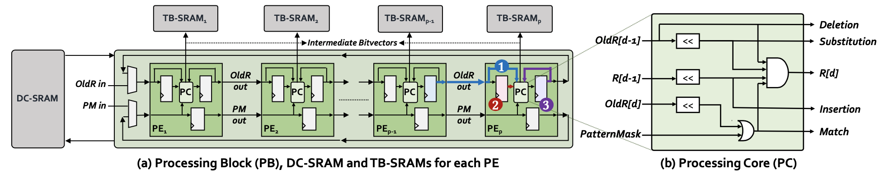
Recall: GenASM-DC’s HW Design
Notes:
(1) T2–R1 (which maps to R[d – 1]) needs to be generated by PE(x–1) in Cycle(y–1)
(2) T1–R1 (which maps to oldR[d – 1]) needs to be generated by PE(x–1) in Cycle(y–2)
(3) T1–R2 (which maps to oldR[d]) needs to be generated by PE(x) in Cycle(y–1)

Slide 43
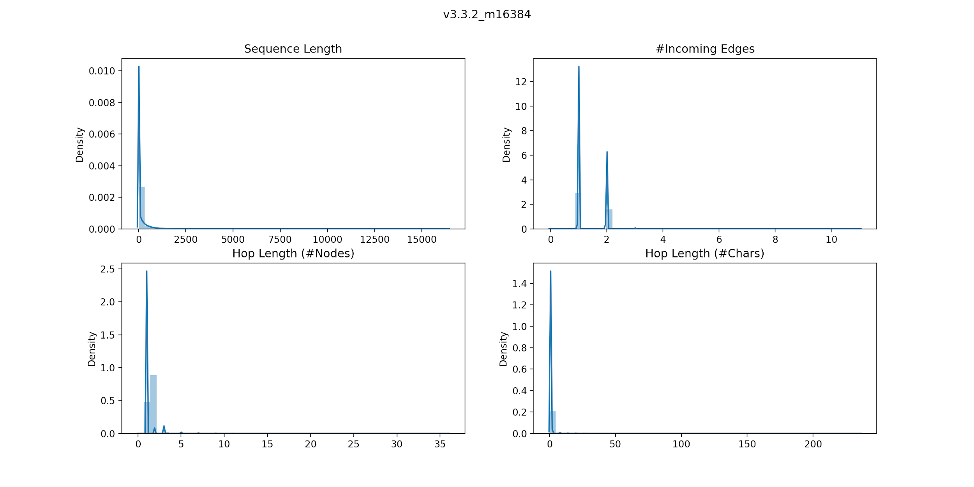
BitAlign – Hop Length Dist Plots

Slide 44
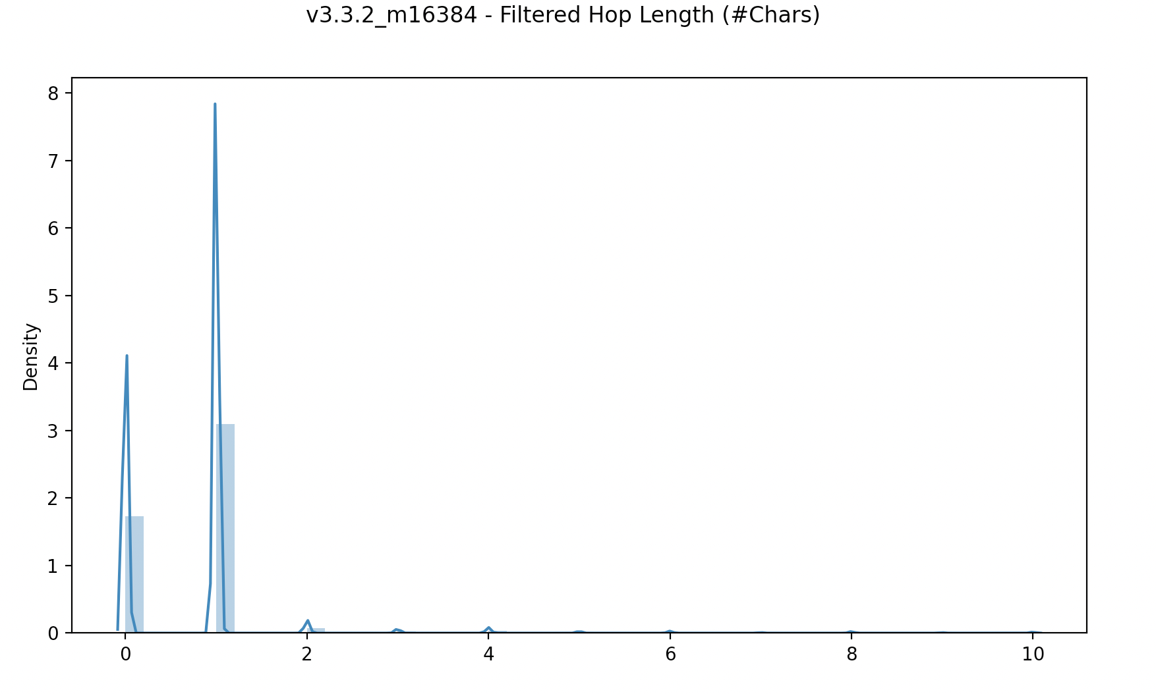
Hop Length Dist Plots (cont’d.)

Slide 45
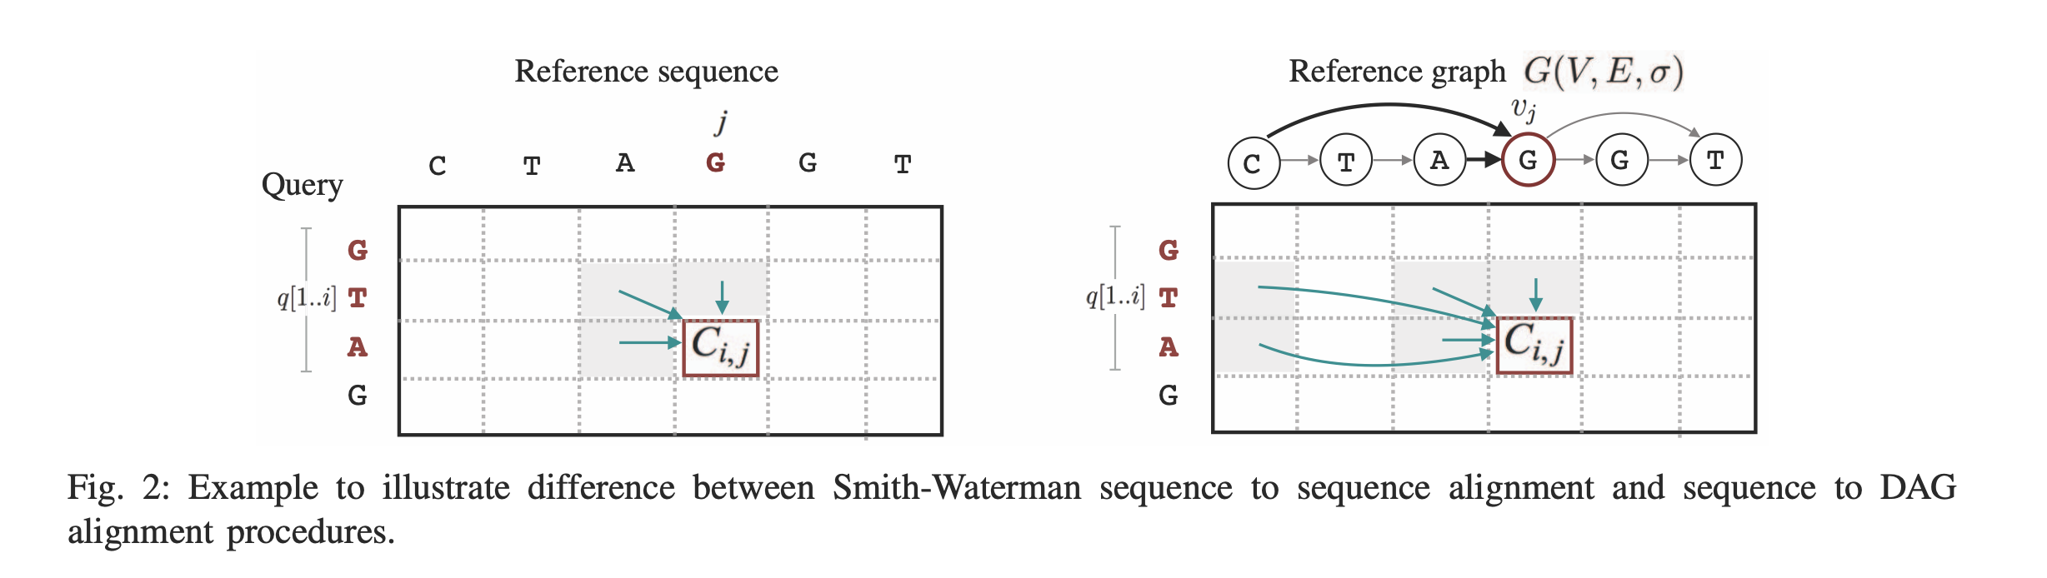
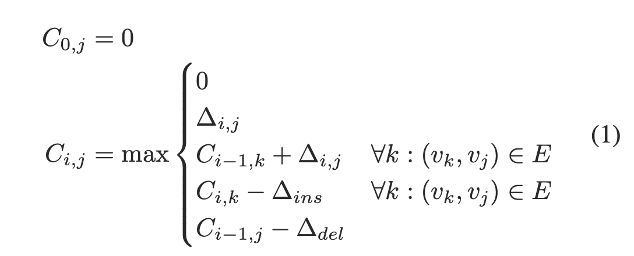
DP-based Graph Alignment
From PaSGAL paper

Slide 46
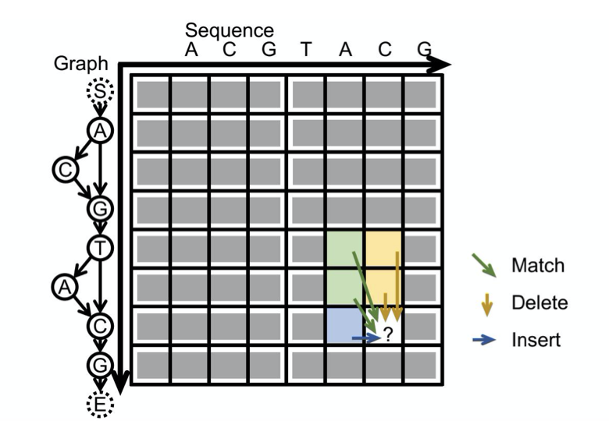
DP-based Graph Alignment (cont’d.)
“abPOA processes all the vectors in a row-by-row manner following the partial order of the graph. During the DP process, for “match” and “delete” operations (diagonal and vertical moves in the DP matrix), all scores stored in each SIMD vector can be updated in parallel as they only rely on scores in the predecessor rows. For “insert” operations (horizontal moves in the DP matrix), sequential non-parallel updating of scores in the same SIMD vector is needed, as the score of each cell depends on the score of the cell on the left.”
From abPOA paper

Slide 47
Backup Slides (GenASM)

Slide 48
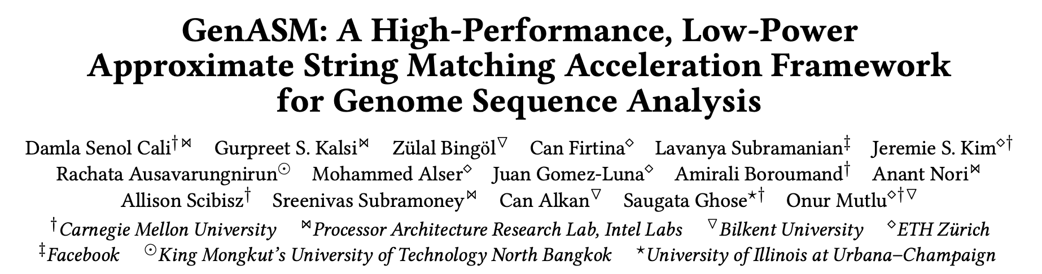
GenASM [MICRO 2020]
Damla Senol Cali, Gurpreet S. Kalsi, Zulal Bingol, Can Firtina, Lavanya Subramanian, Jeremie S. Kim, Rachata Ausavarungnirun, Mohammed Alser, Juan Gomez-Luna, Amirali Boroumand, Anant Nori, Allison Scibisz, Sreenivas Subramoney, Can Alkan, Saugata Ghose, and Onur Mutlu,
"GenASM: A High-Performance, Low-Power Approximate String Matching Acceleration Framework for Genome Sequence Analysis”
Proceedings of the 53rd International Symposium on Microarchitecture (MICRO), Virtual, October 2020.
Notes:
GenASM will appear in MICRO 2020 next week and you can find our pre-print online.

Slide 49
GenASM: ASM Framework for GSA
Our Goal:
Accelerate approximate string matching
by designing a fast and flexible framework,
which can accelerate multiple steps of genome sequence analysis
GenASM: First ASM acceleration framework for GSA
Based upon the Bitap algorithm
Uses fast and simple bitwise operations to perform ASM
Modified and extended ASM algorithm
Highly-parallel Bitap with long read support
Novel bitvector-based algorithm to perform traceback
Co-design of our modified scalable and memory-efficient algorithms with low-power and area-efficient hardware accelerators
Notes:
[CLICK] Our goal in this work is to design a fast and flexible framework for both short and long reads, which can accelerate multiple steps of genome sequence analysis (GSA).
[CLICK] To this end, we propose GenASM.
[CLICK] We base GenASM on Bitap, an ASM algorithm that uses only fast and simple bitwise operations, making it amenable to efficient hardware acceleration. To our knowledge, GenASM is the first work that enhances and accelerates Bitap.
[CLICK] We modify Bitap to support long reads and to enable parallelization.
We also develop a novel Bitap-compatible algorithm for traceback
[CLICK] And, we co-design specialized hardware for both algorithms.

Slide 50
Approximate String Matching
Sequenced genome may not exactly map to the reference genome due to genetic variations and sequencing errors
Approximate string matching (ASM):
Detect the differences and similarities between two sequences
In genomics, ASM is required to:
Find the minimum edit distance (i.e., total number of differences)
Find the optimal alignment with a traceback step
Sequence of matches, substitutions, insertions and deletions, along with their positions
Usually implemented as a dynamic programming (DP) based algorithm
Reference:
Read:
AAAATGTTTAGTGCTACTG
AAAATGTTTACTGCTACTTG
AAAATGTTTAGTGCTACTG
AAATGTTTACTGCTACTTG
AAAATGTTTAGTGCTACTTG
AAAATGTTTAGTGCTACTTG
AAAATGTTTAGTGCTACTG
AAAATGTTTAGTGCTACTTG
A
G
C
T
deletion
substitution
insertion
Notes:
Let’s look at approximate string matching and the bitap algorithm in detail.
As I introduced, the reads may not exactly map to the reference genome due to genetic variations and sequencing errors.
[CLICK] As we can see from this example, these errors and differences (which are also known as edits) can take the form of base [CLICK] deletions, [CLICK] substitutions and [CLICK] insertions.
[CLICK] So we need approximate string matching (ASM).
[CLICK] The goal of approximate string matching is to detect these differences and similarities between two sequences.
[CLICK] In genomics, ASM is required
[CLICK] (1) to determine the minimum number of edits between two genomic sequences (which is called edit distance), and also
[CLICK] (2) to find the optimal alignment with a traceback step., where we find the sequence of matches, substitutions, insertions and deletions, along with their positions.

Slide 51
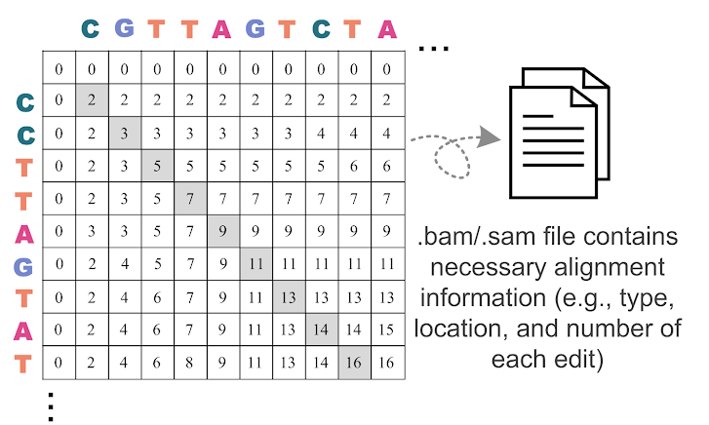
DP-based ASM
Commonly-used algorithm for ASM in genomics…
...with quadratic time and space complexity
Notes:
[CLICK] Approximate string matching is typically implemented as a dynamic programming based algorithm, which has quadratic time and space complexity. Therefore, it is desirable to find lower-complexity algorithms for ASM.

Slide 52
Bitap Algorithm
Bitap^{1,2} performs ASM with fast and simple bitwise operations
Amenable to efficient hardware acceleration
Computes the minimum edit distance between a text (e.g., reference genome) and a pattern (e.g., read) with a maximum of k errors
Step 1: Pre-processing (per pattern)
Generate a pattern bitmask (PM) for each character in the alphabet (A, C, G, T)
Each PM indicates if character exists at each position of the pattern
Step 2: Searching (Edit Distance Calculation)
Compare all characters of the text with the pattern by using:
Pattern bitmasks
Status bitvectors that hold the partial matches
Bitwise operations
[1] R. A. Baeza-Yates and G. H. Gonnet. "A New Approach to Text Searching." CACM, 1992.
[2] S. Wu and U. Manber. "Fast Text Searching: Allowing Errors." CACM, 1992.
Notes:
[CLICK] One candidate to replace DP-based algorithms for ASM is the Bitap algorithm. Bitap uses only fast and simple bitwise operations to perform ASM, making it amenable to efficient hardware acceleration.
[CLICK] Bitap tackles the problem of computing the minimum edit distance between a reference text (e.g., reference genome) and a query pattern (e.g., read) with a maximum of k errors.
The algorithm has two steps. [CLICK]
Bitap starts with a pre-processing procedure
[CLICK] where we generate one pattern bitmask for each character in the alphabet. These pattern bitmasks help us to represent the query pattern in a binary format.
Second step (searching or edit distance calculation) is the main step of the algorithm. Here, [CLICK] we examine each text character one by one, by using
[CLICK] 1) the pre-processed pattern bitmasks,
[CLICK] 2) status bitvectors which are updated at each text iteration and hold the partial match information for the text characters examined so far, and
[CLICK] 3) the simple bitwise operations.

Slide 53
Example for the Bitap Algorithm

Slide 54
Limitations of Bitap
Data Dependency Between Iterations:
Two-level data dependency forces the consecutive iterations to take place sequentially
Notes:
We find that Bitap has five limitations that hinder its applicability and efficient hardware acceleration for genome sequence analysis.
Let’s look at the first one, which is data dependency between large number of iterations

Slide 55
Bitap Algorithm (cont’d.)
Step 2: Edit Distance Calculation
For each character of the text (char):
Copy previous R bitvectors as oldR
R[0] = (oldR[0] << 1) | PM [char]
For d = 1…k:
deletion = oldR[d-1]
substitution = oldR[d-1] << 1
insertion = R[d-1] << 1
match = (oldR[d] << 1) | PM [char]
R[d] = deletion & mismatch & insertion & match
Check MSB of R[d]:
If 1, no match.
If 0, match with d many errors.
Large number of iterations
Notes:
First, Bitap iterates over each text character as the outer loop and it iterates over each possible edit distance (1 to k) as the inner loop.
Thus, when we have long error-prone reads, both of these loops need to iterate over very large numbers.

Slide 56
Bitap Algorithm (cont’d.)
Step 2: Edit Distance Calculation
For each character of the text (char):
Copy previous R bitvectors as oldR
R[0] = (oldR[0] << 1) | PM [char]
For d = 1…k:
deletion = oldR[d-1]
substitution = oldR[d-1] << 1
insertion = R[d-1] << 1
match = (oldR[d] << 1) | PM [char]
R[d] = deletion & mismatch & insertion & match
Check MSB of R[d]:
If 1, no match.
If 0, match with d many errors.
Data dependency between iterations (i.e., no parallelization)
Notes:
On top of this, There is two-level data dependency in Bitap.
[CLICK] There is an outer loop data dependency when computing deletion, substitution and match bitvectors as they require oldR bitvectors which are coming from previous text iteration.
[CLICK] Also, there is an inner loop data dependency when computing insertion bitvector as it requires R[d-1] which is coming from previous inner loop iteration.

Slide 57
Limitations of Bitap
Data Dependency Between Iterations:
Two-level data dependency forces the consecutive iterations to take place sequentially
No Support for Traceback:
Bitap does not include any support for optimal alignment identification
Notes:
Let’s look at the second limitation of Bitap, which is no support for traceback.

Slide 58
Bitap Algorithm (cont’d.)
Step 2: Edit Distance Calculation
For each character of the text (char):
Copy previous R bitvectors as oldR
R[0] = (oldR[0] << 1) | PM [char]
For d = 1…k:
deletion = oldR[d-1]
substitution = oldR[d-1] << 1
insertion = R[d-1] << 1
match = (oldR[d] << 1) | PM [char]
R[d] = deletion & mismatch & insertion & match
Check MSB of R[d]:
If 1, no match.
If 0, match with d many errors.
Does not store and process these intermediate bitvectors to find the optimal alignment (i.e., no traceback)
Notes:
Bitap generates the four intermediate bitvectors but they are not stored and processed with a traceback step to find the optimal alignment

Slide 59
Limitations of Bitap
Algorithm
Data Dependency Between Iterations:
Two-level data dependency forces the consecutive iterations to take place sequentially
No Support for Traceback:
Bitap does not include any support for optimal alignment identification
No Support for Long Reads:
Each bitvector has a length equal to the length of the pattern
Bitwise operations are performed on these bitvectors
Limited Compute Parallelism:
Text-level parallelism
Limited by the number of compute units in existing systems
Limited Memory Bandwidth:
High memory bandwidth required to read and write the computed bitvectors to memory
Hardware
Notes:
[CLICK] We find one more algorithmic limitation, which is no support for long reads. In Bitap, the query length so read length is limited by the word size of the machine running the algorithm because each bitvector has a length equal to the length of the pattern and we perform the bitwise operations on these bitvectors. Thus, the algorithm does not support long reads, whose lengths are on the order of thousands to millions of base pairs
[CLICK] These are the algorithmic limitations of the Bitap algorithm.
Even after we solve the algorithmic limitations of Bitap, we find that we cannot extract significant performance benefits with algorithmic enhancements alone.
[CLICK] 4) For example, while Bitap iterates over each character of the input text sequentially, we can enable text-level parallelism to improve its performance. However, the achievable level of parallelism is limited by the number of compute units in existing systems.
5) We would expect that a GPU, which has thousands of compute units, can overcome the limited compute parallelism issues that CPUs experience. [CLICK] However, we find that a GPU implementation of the Bitap algorithm suffers from the limited amount of memory bandwidth available for each GPU thread.
[CLICK] And these are the HW-related limitations.
In order to overcome these limitations and design an efficient accelerator, we find that we need to both (1) modify and extend the Bitap algorithm and (2) develop specialized hardware that can exploit the new opportunities that our algorithmic modifications provide.

Slide 60
GenASM: ASM Framework for GSA
Approximate string matching (ASM) acceleration framework based on the Bitap algorithm
First ASM acceleration framework for genome sequence analysis
We overcome the five limitations that hinder Bitap’s use in genome sequence analysis:
Modified and extended ASM algorithm
Highly-parallel Bitap with long read support
Novel bitvector-based algorithm to perform traceback
Specialized, low-power and area-efficient hardware for both modified Bitap and novel traceback algorithms
SW
HW
Notes:
To this end, we propose GenASM, an ASM acceleration framework for genome sequence analysis.
[CLICK] To our knowledge, GenASM is the first ASM acceleration framework for GSA and it is also first that enhances and accelerates Bitap. [CLICK] We make significant modifications to Bitap in order to overcome those five limitations.
[CLICK] First, we modify the Bitap algorithm, by extending it to support long reads and by eliminating loop-carried data dependencies to enable parallelization.
[CLICK] Second, we develop a novel Bitap-compatible algorithm for traceback, which uses information collected during ASM about the different types of errors to identify the optimal alignment of reads.
[CLICK] these cover the algorithmic contributions of GenASM
[CLICK] And third, we co-design specialized, low-power and area-efficient hardware for both algorithms.
[CLICK] and this covers the hardware-level contributions of GenASM

Slide 61
GenASM Algorithm
GenASM-DC Algorithm:
Modified Bitap for Distance Calculation
Extended for efficient long read support
Besides bit-parallelism that Bitap has, extended for parallelism:
Loop unrolling
Text-level parallelism
GenASM-TB Algorithm:
Novel Bitap-compatible TraceBack algorithm
Walks through the intermediate bitvectors (match, deletion, substitution, insertion) generated by GenASM-DC
Follows a divide-and-conquer approach to decrease the memory footprint
Notes:
[CLICK] Our first algorithm GenASM-DC
[CLICK] is the modified Bitap algorithm for distance calculation, where
[CLICK] we extend it to provide efficient support for long reads, and
[CLICK] we enable parallelism besides bit-parallelism that baseline Bitap provides by
[CLICK] performing loop unrolling and removing the loop dependencies and
[CLICK] exploiting text-level parallelism, where we divide the text into overlapping sub-texts and search the query in each of these sub-texts in parallel.
[CLICK] Our second algorithm, GenASM-TB, is a novel Bitap-compatible traceback algorithm,.
[CLICK] which walks through the intermediate bitvectors (match, deletion, substitution, insertion) generated by GenASM-DC and finds the optimal alignment.
[CLICK] In order to decrease the memory footprint of the algorithm, it follows a divide-and-conquer approach, where we divide the text and pattern into overlapping windows and perform the traceback computation for each window. After all of the windows’ partial traceback outputs are generated, we merge them to find the complete traceback output.

Slide 62
Loop Unrolling in GenASM-DC

Slide 63
Traceback Example with GenASM-TB

Slide 64
GenASM Hardware Design
Main Memory
GenASM-DC
GenASM-DC
GenASM-TB
GenASM-DC
Accelerator
GenASM-TB
GenASM-DC
Accelerator
DC-SRAM
DC-SRAM
TB-SRAM₁
TB-SRAM₁
GenASM-TB
Accelerator
GenASM-TB
Accelerator
TB-SRAM₂
Host CPU
TB-SRAM₂
.
.
.
TB-SRAM_{n}
TB-SRAM_{n}
GenASM-DC:
generates bitvectors
and performs edit
Distance Calculation
GenASM-TB: performs TraceBack and assembles the optimal alignment
Notes:
Let’s look at the HW design of GenASM.
Our co-designed hardware consists of two components:
[CLICK] (1) GenASM-DC, which provides hardware support to efficiently execute our GenASM-DC algorithm to perform distance calculation; and
[CLICK] (2) GenASM-TB, which provides hardware support to efficiently execute our novel GenASM-TB algorithm to find the optimal alignment.
GenASM also has two types of SRAM buffers: [CLICK] DC-SRAM and [CLICK] TB-SRAMs
Let’s look at the high-level overview of GenASM

Slide 65
GenASM Hardware Design
Main Memory
GenASM-DC
GenASM-DC
GenASM-TB
GenASM-DC
Accelerator
GenASM-TB
GenASM-DC
Accelerator
DC-SRAM
DC-SRAM
2
2
reference text
& query pattern
7
reference text
& query pattern
sub-text &
sub-pattern
Find the
traceback output
3
sub-text &
sub-pattern
3
TB-SRAM₁
TB-SRAM₁
GenASM-TB
Accelerator
GenASM-TB
Accelerator
6
5
6
5
TB-SRAM₂
Host CPU
TB-SRAM₂
Write
bitvectors
Write
bitvectors
Read
bitvectors
.
.
.
Read
bitvectors
1
1
TB-SRAM_{n}
reference & query locations
TB-SRAM_{n}
reference & query locations
Generate
bitvectors
Generate
bitvectors
4
4
GenASM-DC:
generates bitvectors
and performs edit
Distance Calculation
GenASM-TB: performs TraceBack and assembles the optimal alignment
Notes:
[CLICK] GenASM execution starts when the host CPU issues a task to GenASM with the reference and the query sequences’ locations.
[CLICK] GenASM-DC reads the corresponding reference text region and the query pattern from the memory, and then writes these to its dedicated SRAM, DC-SRAM.
In order to decrease the memory footprint of the algorithm, it follows a divide-and-conquer approach, where we divide the text and pattern into overlapping windows and perform the traceback computation for each window. After all of the windows’ partial traceback outputs are generated, we merge them to find the complete traceback output.
[CLICK] After that, GenASM-DC divides the reference text and query pattern into multiple overlapping windows, and
[CLICK] for each sub-text and sub-pattern, GenASM-DC searches for the sub-pattern within the sub-text and generates the bitvectors.
[CLICK] GenASM-DC writes the generated bitvectors to TB-SRAMs. Once GenASM-DC completes its search for the current window,
[CLICK] GenASM-TB starts reading the stored bitvectors from TB-SRAMs and
[CLICK] generates the window’s traceback output.
Once GenASM-TB generates this output, GenASM computes the next window and repeats Steps 3–7 until all windows are completed.

Slide 66
GenASM Hardware Design
Main Memory
GenASM-DC
GenASM-DC
GenASM-TB
GenASM-DC
Accelerator
GenASM-TB
GenASM-DC
Accelerator
DC-SRAM
DC-SRAM
2
reference text
& query pattern
7
sub-text &
sub-pattern
Find the
traceback output
3
TB-SRAM₁
TB-SRAM₁
GenASM-TB
Accelerator
GenASM-TB
Accelerator
5
TB-SRAM₂
6
Host CPU
TB-SRAM₂
Write
bitvectors
.
.
.
Read
bitvectors
1
TB-SRAM_{n}
reference & query locations
TB-SRAM_{n}
Generate
bitvectors
4
GenASM-DC:
generates bitvectors
and performs edit
Distance Calculation
GenASM-TB: performs TraceBack and assembles the optimal alignment
Our specialized compute units and on-chip SRAMs help us to:
Match the rate of computation with memory capacity and bandwidth
Achieve high performance and power efficiency
Scale linearly in performance with the number of parallel compute units that we add to the system
Notes:
[CLICK] Our specialized compute units and on-chip SRAMs helps us to:
[CLICK] (1) Match the rate of computation with memory capacity and bandwidth
[CLICK] (2) Achieve high performance and power efficiency
[CLICK] (3) Scale linearly in performance with the number of parallel compute units that we add to the system

Slide 67
GenASM-DC: Hardware Design
Linear cyclic systolic array-based accelerator
Designed to maximize parallelism and minimize memory bandwidth and memory footprint
Processing Block (PB)
Processing Core (PC)
Notes:
Let's look at GenASM-DC's hardware design.
[CLICK] We implement GenASM-DC as a linear cyclic systolic array based accelerator, using small and very simple logic components.
[CLICK] This design helps us to maximize parallelism and minimize memory BW and footprint.
[CLICK] Processing Core is the basic compute component which computes the intermediate bitvectors
[CLICK] and when we add the flip-flop-based storage logic around Processing Core, we define a Processing Element (PE)
[CLICK] Multiple PEs are concatenated to define a Processing Block
[CLICK] We also have DC-SRAM, which stores the reference text, the pattern bitmasks for the query read, and the intermediate data generated from PEs, and we also have
[CLICK] TB-SRAMs, which store the intermediate bitvectors generated by each PE of GenASM-DC for later use by GenASM-TB.

Slide 68
GenASM-TB: Hardware Design
1
1
Last CIGAR
1
2
.
.
64
Last CIGAR
1
2
.
.
64
64
64
match
match
2
2
CIGAR string
CIGAR string
Bitwise Comparisons
64
Bitwise Comparisons
64
insertion
insertion
CIGAR
out
192
CIGAR
out
192
deletion
64
deletion
64
3
3
Next Rd Addr Compute
subs
Next Rd Addr Compute
64
subs
64
<<
<<
1.5KB
TB-SRAM₁
1.5KB
TB-SRAM₂
GenASM-TB
1.5KB
TB-SRAM₆₄
to main
memory
Very simple logic:
❶Reads the bitvectors from one of the TB-SRAMs using the computed address
❷Performs the required bitwise comparisons to find the traceback output for the current position
❸Computes the next TB-SRAM address to read the new set of bitvectors
1
2
3
Notes:
[CLICK] We implement GenASM-TB hardware using very simple logic, which
[CLICK] 1) reads the bitvectors from one of the TB-SRAMs using the computed address,
[CLICK] 2) performs the required bitwise comparisons to find the traceback output for the current position, and
[CLICK] 3) computes the next TB-SRAM address to read the new set of bitvectors.
After GenASM-TB finds the complete traceback output (which is also called CIGAR string), [CLICK] it writes the output to main memory and completes its execution.

Slide 69
Use Cases of GenASM
Read Alignment Step of Read Mapping
Find the optimal alignment of how reads map to candidate reference regions
Pre-Alignment Filtering for Short Reads
Quickly identify and filter out the unlikely candidate reference regions for each read
Edit Distance Calculation
Measure the similarity or distance between two sequences
We also discuss other possible use cases of GenASM in our paper:
Read-to-read overlap finding, hash-table based indexing, whole genome alignment, generic text search
Notes:
We demonstrate the efficiency and flexibility of the GenASM acceleration framework by describing three use cases of approximate string matching in genome sequence analysis:
[CLICK] (1) read alignment step of short and long read mapping,
[CLICK] (2) pre-alignment filtering for short reads,
[CLICK] (3) edit distance calculation between any two arbitrary-length sequences, which is one of the fundamental operations in genomics that measures the similarity or distance btw two sequences
[CLICK] We believe the GenASM framework can be useful for many other use cases, and we discuss some of them briefly in our paper, including generic text search

Slide 70
Evaluation Methodology
We evaluate GenASM using:
Synthesized SystemVerilog models of the GenASM-DC and GenASM-TB accelerator datapaths
Detailed simulation-based performance modeling
16GB HMC-like 3D-stacked DRAM architecture
32 vaults
256GB/s of internal bandwidth, clock frequency of 1.25GHz
In order to achieve high parallelism and low power-consumption
Within each vault, the logic layer contains a GenASM-DC accelerator, its associated DC-SRAM, a GenASM-TB accelerator, and TB-SRAMs.
Notes:
Let’s look at our evaluation of the GenASM design and framework.
[CLICK] We evaluate GenASM using a combination of
(1) synthesis of our DC and TB accelerator datapaths, and
(2) detailed simulation-based performance modeling
[CLICK] We evaluate a 16GB HMC-like 3D-stacked DRAM arch, with 32 vaults. Our accelerators can be ported anywhere in the system, but in order to achieve high parallelism and low power-consumption, we place GenASM-DC and GenASM-TB in the logic layer of 3D-stacked memory. As I will show next, our hardware is highly efficient in terms of both area and power, so they are within the budget limits of the logic layer.

Slide 71
Evaluation Methodology (cont’d.)
 | SW Baselines | HW Baselines
Read Alignment | Minimap2¹ BWA-MEM² | GACT (Darwin)³ SillaX (GenAx)⁴
Pre-Alignment Filtering | – | Shouji⁵
Edit Distance Calculation | Edlib⁶ | ASAP⁷
[1] H. Li. "Minimap2: Pairwise Alignment for Nucleotide Sequences." In Bioinformatics, 2018.
[2] H. Li. "Aligning sequence reads, clone sequences and assembly contigs with BWA-MEM." In arXiv, 2013.
[3] Y. Turakhia et al. "Darwin: A genomics co-processor provides up to 15,000 x acceleration on long read assembly." In ASPLOS, 2018.
[4] D. Fujiki et al. "GenAx: A genome sequencing accelerator." In ISCA, 2018.
[5] M. Alser. "Shouji: A fast and efficient pre-alignment filter for sequence alignment." In Bioinformatics, 2019.
[6] M. Šošić et al. "Edlib: A C/C++ library for fast, exact sequence alignment using edit distance." In Bioinformatics, 2017.
[7] S.S. Banerjee et al. ”ASAP: Accelerated short-read alignment on programmable hardware." In TC, 2018.
Notes:
[CLICK] For the use cases we evaluate, we compare GenASM with state-of-the-art SW and HW baselines.

Slide 72
Evaluation Methodology (cont’d.)
For Use Case 1: Read Alignment, we compare GenASM with:
Minimap2 and BWA-MEM (state-of-the-art SW)
Running on Intel® Xeon® Gold 6126 CPU (12-core) operating @2.60GHz with 64GB DDR4 memory
Using two simulated datasets:
Long ONT and PacBio reads: 10Kbp reads, 10-15% error rate
Short Illumina reads: 100-250bp reads, 5% error rate
GACT of Darwin and SillaX of GenAx (state-of-the-art HW)
Open-source RTL for GACT
Data reported by the original work for SillaX
GACT is best for long reads, SillaX is best for short reads
Notes:
I won’t go into details, but you can refer to our paper for more details or I am happy to answer your questions at the end.

Slide 73
Evaluation Methodology (cont’d.)
For Use Case 2: Pre-Alignment Filtering, we compare GenASM with:
Shouji (state-of-the-art HW – FPGA-based filter)
Using two datasets provided as test cases:
100bp reference-read pairs with an edit distance threshold of 5
250bp reference-read pairs with an edit distance threshold of 15
For Use Case 3: Edit Distance Calculation, we compare GenASM with:
Edlib (state-of-the-art SW)
Using two 100Kbp and 1Mbp sequences with similarity ranging between 60%-99%
ASAP (state-of-the-art HW – FPGA-based accelerator)
Using data reported by the original work

Slide 74
Key Results – Area and Power
Based on our synthesis of GenASM-DC and GenASM-TB accelerator datapaths using the Synopsys Design Compiler with a 28nm process:
Both GenASM-DC and GenASM-TB operate @ 1GHz
Total (1 vault): 0.334 mm² 0.101 W
Total (32 vaults): 10.69 mm² 3.23 W
% of a Xeon CPU core: 1% 1%
Notes:
[CLICK] We synthesize our DC and TB accelerator datapaths with a typical 28nm process:
[CLICK] Both accelerators operates at 1GHz.
[CLICK] We find that for 32 GenASM accelerator (one for each HMC vault), total area overhead is ten point sixty nine millimeter square and total power consumption is three point twenty-three watts.
We observe that both area and power consumption of GenASM (at 1 vault) is around 1% of the area and power consumption of a single Xeon CPU core.

Slide 75
Key Results – Area and Power
Based on our synthesis of GenASM-DC and GenASM-TB accelerator datapaths using the Synopsys Design Compiler with a 28nm LP process:
Both GenASM-DC and GenASM-TB operate @ 1GHz
GenASM has low area and power overheads
Notes:
Thus, GenASM has low area and power overheads.

Slide 76
Key Results – Use Case 1
Read Alignment Step of Read Mapping
Find the optimal alignment of how reads map to candidate reference regions
Pre-Alignment Filtering for Short Reads
Quickly identify and filter out the unlikely candidate reference regions for each read
Edit Distance Calculation
Measure the similarity or distance between two sequences
Notes:
Let’s look at our results for the first use case: read alignment

Slide 77
Key Results – Use Case 1 (Long Reads)
116×
648×
GenASM achieves 648× and 116× speedup over
12-thread runs of BWA-MEM and Minimap2,
while reducing power consumption by 34× and 37×
SW
Notes:
[CLICK] As software baselines, we compare GenASM with BWA-MEM (which is shown with red bars) and Minimap2 (which is shown with purple bars). Both are commonly used, state-of-the-art read mappers.
[CLICK] We find that GenASM achieves [CLICK] six hundred and forty eight times speedup over 12-thread run of BWA-MEM and [CLICK] a hundred and sixteen times speedup over 12-thread run of Minimap2 (SW), [CLICK] while reducing power consumption by thirty four times and thirty seven times.

Slide 78
Key Results – Use Case 1 (Long Reads)
3.9×
HW
GenASM provides 3.9× better throughput,
6.6× the throughput per unit area, and
10.5× the throughput per unit power,
compared to GACT of Darwin
Notes:
[CLICK] Compared to GACT of Darwin, which is a state-of-the-art long read alignment accelerator, [CLICK] GenASM provides 3.9 times better throughput, [CLICK] 6.6 times better throughput per unit area, and 10.5 times better throughput per unit power.

Slide 79
Key Results – Use Case 1 (Short Reads)
158×
111×
SW
GenASM achieves 111× and 158× speedup over
12-thread runs of BWA-MEM and Minimap2,
while reducing power consumption by 33× and 31×
GenASM provides 1.9× better throughput and
uses 63% less logic area and 82% less logic power,
compared to SillaX of GenAx
HW
Notes:
[CLICK] For short reads, compared to same SW baselines, [CLICK] [CLICK] [CLICK] GenASM provides significant speedup and reduction in power consumption, similar to long reads.
[CLICK] Compared to SillaX of GenAx, which is a state-of-the-art short read alignment accelerator, GenASM provides 1.9 times better throughput, while using 63% less logic area and 82% less logic power.

Slide 80
Key Results – Use Case 2
Read Alignment Step of Read Mapping
Find the optimal alignment of how reads map to candidate reference regions
Pre-Alignment Filtering for Short Reads
Quickly identify and filter out the unlikely candidate reference regions for each read
Edit Distance Calculation
Measure the similarity or distance between two sequences
Notes:
Let’s briefly look at our results for our second use case: pre-alignment filtering

Slide 81
Key Results – Use Case 2
Compared to Shouji:
3.7× speedup
1.7× less power consumption
False accept rate of 0.02% for GenASM vs. 4% for Shouji
False reject rate of 0% for both GenASM and Shouji
GenASM is more efficient in terms of
both speed and power consumption,
while significantly improving the accuracy
of pre-alignment filtering
HW
Notes:
[CLICK] Here is the key takeaway:
Compared to Shouji, which is a state-of-the-art FPGA-based filter, GenASM is more efficient in terms of both speed and power consumption, while significantly improving the accuracy of pre-alignment filtering

Slide 82
Key Results – Use Case 3
Read Alignment Step of Read Mapping
Find the optimal alignment of how reads map to candidate reference regions
Pre-Alignment Filtering for Short Reads
Quickly identify and filter out the unlikely candidate reference regions for each read
Edit Distance Calculation
Measure the similarity or distance between two sequences
Notes:
Similarly, let’s briefly look at our results for the third use case: edit distance calculation

Slide 83
Key Results – Use Case 3
12501×
627×
146×
1458×
GenASM provides 146 – 1458× and 627 – 12501× speedup,
while reducing power consumption by 548× and 582×
for 100Kbp and 1Mbp sequences, respectively, compared to Edlib
SW
GenASM provides 9.3 – 400× speedup over ASAP,
while consuming 67× less power
HW
Notes:
Here are the key takeaways:
Compared to the SW baseline, Edlib, GenASM provides 2 to 4 orders of magnitude speedup, while reducing power consumption by 2 orders of magnitude.
And compared to the HW baseline, ASAP, GenASM provides 9.3 to 400 times speedup, while consuming 67 times less power

Slide 84
Additional Details in the Paper
Details of the GenASM-DC and GenASM-TB algorithms
Big-O analysis of the algorithms
Detailed explanation of evaluated use cases
Evaluation methodology details (datasets, baselines, performance model)
Additional results for the three evaluated use cases
Sources of improvements in GenASM (algorithm-level, hardware-level, technology-level)
Discussion of four other potential use cases of GenASM
Notes:
Before I summarize GenASM, here is the list of additional details that you can find in our paper.

Slide 85
Summary of GenASM
Problem:
Genome sequence analysis is bottlenecked by the computational power and memory bandwidth limitations of existing systems
This bottleneck is particularly an issue for approximate string matching
Key Contributions:
GenASM: An approximate string matching (ASM) acceleration framework to accelerate multiple steps of genome sequence analysis
First to enhance and accelerate Bitap for ASM with genomic sequences
Co-design of our modified scalable and memory-efficient algorithms with low-power and area-efficient hardware accelerators
Evaluation of three different use cases: read alignment, pre-alignment filtering, edit distance calculation
Key Results: GenASM is significantly more efficient for all the three use cases (in terms of throughput and throughput per unit power) than state-of-the-art software and hardware baselines
Notes:
[CLICK] To summarize, in this work, we focus on approximate string matching because it is one of the main bottlenecks of genome sequence analysis.
[CLICK] We propose GenASM, an approximate string matching (ASM) acceleration framework to accelerate multiple steps of genome sequence analysis
[CLICK] GenASM is the first work that enhances and accelerates Bitap for ASM with genomic sequences
[CLICK] In GenASM, we co-design our modified scalable and memory-efficient algorithms with low-power and area-efficient hardware accelerators
[CLICK] We evaluate three different use cases and
[CLICK] we show that GenASM is significantly more efficient for all the three use cases (in terms of throughput and throughput per unit power) than state-of-the-art software and hardware baselines

Slide 86
GenGraph: A Hardware Acceleration Framework for Sequence-to-Graph Mapping
Damla Senol Cali et al.
https://damlasenolcali.github.io
TECHCON’21 ⎼ September 14, 2021
This work was supported in part by Semiconductor Research Corporation (SRC).

